Slide 1
Iowa Change Leadership Vision Council Leadership Development Program Orientation funded by the Mid-Iowa Health Foundation

Slide 2
VISION COUNCIL RESULTS PLAYBOOK (DRAFT)

Slide 3
Vision Council’s North Star and Approach
North Star Outcome
Children & families in Iowa are safe & secure, healthy & well in their communities.
How
Reach the North Star through a focus on children and families in the child welfare system or at-risk; through lenses of race equity and trauma.
Use Data To:
Identify Needs
Define Desired Results
Track Progress
Working Collaboratively within the Vision Council and beyond
Change the systems’ culture to be more constructive.
Notes:
FOUNDING GOAL To engage the public and private sectors to collaborate and be solution-focused to create a child welfare system to meet the needs of Iowa’s children and families living at risk of poor outcomes.

Slide 4
Change Leadership Vision Council
System Culture Shift
FROM Defensive Style | TO Constructive Style
Current Assessed State: Compliance Mindset | Overall Goal for the System: Move to a Value-Based Mindset
Current Assessed Behaviors: | Ideal Behaviors:
1. Communicating only “What” | 1. Communicating “What and Why”
2. Fix-it Mindset | 2. Progress Mindset
3. Fear of risk and change | 3. Be an agent of change, be proactive and increase advocacy
4. Geographic Alignment | 4. Goal Alignment
5. Outcomes measured by negative indicators | 5. Outcomes measured by positive indicators
This System Culture Shift proposal was drafted by the Change Leadership Vision Council, a public-private initiative convened by The Coalition for Family and Children Services in Iowa, funded by the Mid-Iowa Health Foundation.
CONTACT: Kelli Soyer, MSW, LMSW, Associate Director, at kelli@iachild.org

Slide 5
What will it take to ensure all Iowa children and families are safe, secure, healthy and well in their communities?
What will it take to stabilize families in their communities so that children do not need to enter out-of-home care?
If we shift our thinking from how to protect children from families that are in crisis to creating societal conditions that equitably protect and strengthen families, then we will be closer to being a source of prevention.
“Stop saving us from our families. Save our families FOR us!”
– A youth in foster care

Slide 6
The Iowa Change Leadership Vision Council
DRAFT
Iowans are supportive of strong families and communities. It shows in data about our state. Iowa’s rank as #3 in a national Opportunity Index suggests that most Iowans can rely on the foundational building blocks of employment, education and learning opportunities, physical, mental and behavioral health care, homes in thriving neighborhoods, enough food for an active, healthy life, and vibrant communities.
The Iowa Change Leadership Vision Council, sponsored by the Mid-Iowa Health Foundation as a project of the Coalition of Family and Children’s Services in Iowa, seeks to align the collective efforts of organizations, government, and communities to help Iowa do even better for families and children. A public-private partnership of leaders working every day with the families who collide with structural inequities in their lives and where they live, the Vision Council studied how to build up the right kinds of supports so that more of our children and families thrive. Our vision is that “all Iowa children and families are safe, secure, healthy and well in their communities.”
We know that when a foundational building block is missing or crumbling out from under a family, stress levels rise. Most families live with supports that equip them to recover from mild pressures, like temporary job loss or a recoverable illness. But overwhelming stress from limited access to an adequate array and availability of jobs, insufficient or incomplete education, unsafe living conditions, disconnection from health care coverage and access, and weakened neighborhoods, can keep children and families from achieving their full potential.
Because we are a community of leaders interacting daily with Iowa’s children and families who are living with shaky foundations, we can see that there are pressures that cause stressful situations, which can lead to child maltreatment. In most cases, we observe that children who have experienced maltreatment are in situations where multiple pressures are co-occurring. After a deep review of data and research, the Vision Council believes that too many Iowa families are living and working within structural inequities that actively build up pressure in their homes. When it builds too high, children can become the victims of harm that will impact their development and opportunities for the rest of their lives. These high-pressure situations, and the harm that can result, are often preventable.
Structural inequities occur when situations and systems, and the decisions and policies that impact them, are not designed to ensure success. The Vision Council is focusing our strategies and advocacy on addressing structural inequities, ensuring instrumental supports are there when families need them to re-build their strength, and cultivating protective factors in individuals, families, communities and systems. We know our work builds on Iowan’s strong commitment to child, family and community well-being.

Slide 7
Indicators relevant to the Vision Council’s North Star Outcome (Structural Inequities)
“Iowa families and children are safe, secure, healthy and well in their communities.”
DRAFT
Indicators | Measure/Source | Note
Principal Issue: Concentrated Community Disadvantage (CCD)
Financial Security | Child poverty Unemployment | Concentrated Community Disadvantage (CCD); correlated with child maltreatment
Parental education attainment | Adults with a high school diploma (county level) | Correlated with child maltreatment
Housing instability | Severe housing problems (county level) | CCD; Correlated with child maltreatment
Food insecurity | Free/Reduced Lunch | Somewhat correlated with child maltreatment
Uninsurance | Uninsured under age 65 (CHR) Uninsured under age 19 (CHR) | Somewhat correlated with child maltreatment
Social Disorder | Excessive drinking (County Health Rankings) Substance Use in child maltreatment cases (Iowa DHS) | CCD; indicator of fewer resources overall; Social disorder is linked to child maltreatment

Slide 8
Key:
Red = correlates w/ child maltreatment
Blue = Family First Prevention Services Act helps with
Purple = financial strategies proven to reduce entries into CWS
Leading Indicators Cross-Referenced to North Star Outcome
DRAFT
 | Type of Support | Strategies (DRAFT) | Notes
Safe - Feeling nurtured and protected. | Housing | Prioritize housing Identify and meet with housing leaders/stakeholders Advocate for housing to be a part of IDPH/DHS alignment Partner with DHS to conduct in-depth Family Wellness Assessment (use WI instrument) | Correlation with child maltreatment *Differential response with instrumental supports *Housing
Secure - Having enough resources for a quality of life. | Financial assistance Employment Transportation |  | Correlation with child maltreatment *EITC *Minimum wage increase
Healthy - Enjoying good health and expecting to live a full life. | Health care access Food security SUD and MH treatment |  | Some correlation with child maltreatment *Medicaid Expansion Some correlation with child maltreatment
Well - Thriving and resilient with a strong economy and opportunities to learn. | Parental education opportunity Child care Services to address special needs |  | Correlation with child maltreatment Correlation to child maltreatment
In their communities - Living among family and social networks who help each other live well. | Parent skill building Supportive communities and relationships Caring adults outside of the home |  | FFPSA helps address *Home visiting with instrumental supports

Slide 9
Whole Population to System Population to Strategic Populations to Program Populations ^{[1]}
STRATEGIC POPULATIONS
#1: Older Youth (Program Population: Older youth of color in/at risk of out-of-home placements)
#2: Children and Their Families Living with Substance Use Disorders (Program Population: Families with young children)
WHOLE POPULATION All Iowa children and families
SYSTEM POPULATION FOCUS
All children and families involved in the Iowa Child Welfare System or at risk of becoming involved
STRATEGIC POPULATIONS
#1: Older Youth
#2: Children and Their Families Living
with Substance Use Disorders
PROGRAM POPULATIONS
#1: Older youth of color in/at risk of
out-of-home placements
#2: Families with Young Children
Living with SUDs

Slide 10
Overview:
Results-Based Accountability/Facilitation Models (RBA and RBF)

Slide 11
5-2-2 of RESULTS COUNTTM
5 Core Competencies
Be results-based and data-driven with clear targets, data to assess progress and change course.
Acts on disparities to advance equitable opportunities. Recognize that race, class and culture impact outcomes and opportunities for vulnerable children.
Use oneself as an instrument of change to move a result; individual leaders can lead from whatever position they hold.
Master the skills of “adaptive leadership,” awareness of how values, habits, beliefs, attitudes and behaviors impact action for results.
Collaborate with others, understanding that the capacity to build consensus and make group decisions enables leaders to align their actions and move work forward to achieve results.
2 Foundational Frameworks
Theory of Aligned Contributions: The right group of leaders using specific skills to align actions and make contributions from role will result in measurable population level change.
Person-Role-System: Leadership is influenced by individual preferences, professional experiences, and the role one plays in formal and informal systems.
2 Foundational Skills
Results-Based Accountability: Differentiates population and program level results, uses data to develop impactful strategies and tracks whether work is contributing to results.
Results-Based Facilitation: Leaders design, lead and contribute to meetings that move groups from talk to action and hold participants accountable for advancing the work.
Results CountTM is The Annie E. Casey Foundation’s (AECF) program for teaching and spreading the Results-Based Model. AECF developed the 5-2-2 Framework.
Notes:
The Vision Council is using the Results-Based Model to ensure a brighter future for all children and families in Iowa.
The work of leaders is to align their actions in ways that make a measurable contribution to better results for all members of a defined population
In this work, “all” means just that and focusing on all members of a defined group requires a relentless focus on equity. That focus is reflected throughout the Results-Based approach.
ASSUMPTIONS
People want to make a difference.
When people are working to make a difference, they want to KNOW (through data / evidence) that they are making a difference.
People can use the Results-Based competencies, frameworks and tools to help them know and track that they are making a difference.
If leaders perform better in role and if they align their actions with other partners, then they will have greater and more equitable impact on the populations they are working with and on behalf of.

Slide 12
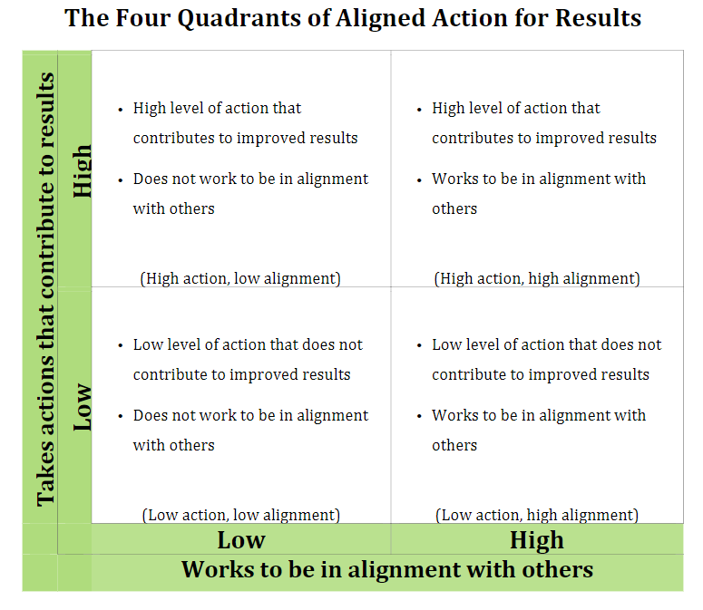
The Theory of Aligned Contributions*
The Call to Action: Leaders place population results at the center of their work with a sense of urgency.
The Container: The place, time and tools to accelerate results.
The Capacity to Collaborate: Leaders use Results-Based skills and competencies to hold individual and collective accountability for equitable results at the population level and their contribution to those equitable results.
*Theory of Aligned Contributions, Jolie Bain Pillsbury
http://www.sherbrookeconsulting.com/products/TOAC.pdf
Adapted from slides contributed by Sheila Weber, The OCL Group

Slide 13
Theory of Aligned Contributions
Measurable Population Level Improvement on a Condition of Well-Being for Children and Families
A Sense of Urgency
Public Accountability
Aligned Contributions
Leaders from Across Sectors Take Aligned Action at a Specified Scope and Scale
Focus on a Measurable Result
Leaders Collaborate and Take a Skilled Approach
Make Decisions Together
Move From Talk to Action
Do Adaptive Work
Be Accountable for Making Measurable Difference
Notes:
The Call to Action: Leaders place population results at the center of their work with a sense of urgency
The Container: The place, time and tools to accelerate results
The Capacity to Collaborate: Leaders use competencies to hold individual and collective accountability for population results and their contribution to results

Slide 14
3 Hypotheses of RBF p. 13, RBF Book 1
1
2
3
The work of meetings occurs through conversations.
Conversation is defined as people listening and talking about the same things at the same time.
Group conversations can be designed, prepared for & flexibly supported by someone with a specific set of listening and speaking skills.
A person holding a neutral role, using a set of listening and speaking skills to support the work of a group, can accelerate the work of the group.
Adapted from slides contributed by Sheila Weber, The OCL Group

Slide 15
Results Based Facilitation (RBF) Competencies & Skills
Hold Roles
Use B/ART to differentiate roles
Use B/ART to understand group dynamics
Hold neutral facilitator role
Give the work back to the group
Hold Conversations
Appreciative Openness
Context Statements, Effective Questions, Listen For
Hold Groups
Flip chart
Sequence
Summarize
Synthesize
Check-in & Check-out
Hold 3R Meetings
Use 3Rs to design
Use 3Rs to achieve results
Hold Mental Models
PBDM
Conversations → convergence
Barriers to convergence
Make action commitments
Accountable
Obs. & resp. to group dynamics
Assess & address conflict
Hold Action and Results
Accountable in role for contribution
Use RBF skills to work collaboratively to accelerate progress toward results
← Foundation Skills & Competencies →
← Advanced →
Note: These competencies and skills are covered in each of the RBF Books: Book 1, pg. 29, Book 2, pg. 4
Adapted from slides contributed by Sheila Weber, The OCL Group

Slide 16
Stages of Competence (p. 30, RBF Book 1)
Unconscious Competence (Mastery)
Conscious Competence (Application)
Conscious Incompetence (Awareness)
Unconscious Incompetence
Adapted from slides contributed by Sheila Weber, The OCL Group

Slide 17
TWO KEY CONCEPTS
Person-Role-System
B/ART
Boundary of Authority, Role, and Task
Role
v
Person
B/ART
Role
System
Authority
Task
Adapted from slides contributed by Sheila Weber, The OCL Group

Slide 18
PERSON-ROLE-SYSTEM
v
Person
Role
System
Adapted from slides contributed by Sheila Weber, The OCL Group

Slide 19
BOUNDARY OF AUTHORITY, ROLE, TASK
B/ART
B/ART
In a group, the B/ART of each participant illuminates the possibilities of the work the group could do together
B/ART
B/ART
B/ART
Adapted from slides contributed by Sheila Weber, The OCL Group

Slide 20
BOUNDARY OF AUTHORITY, ROLE, TASK
Role
The B/ART of the group clarifies the role and tasks the group is authorized to do.
The Convener of the group provides this authorization.
B/ART
Authority
Task
Adapted from slides contributed by Sheila Weber, The OCL Group

Slide 21
OVERVIEW:
LEADERSHIP DEVELOPMENT PROGRAM

Slide 22
Leadership Development Program Expected Results
1
Awareness of adaptive leadership and Results-Based Facilitation (RBF) skills.
3
Preparedness to model the skills and promote their use to encourage aligned actions among Iowa leaders.
2
Application of these skills in support of the work of leaders to align actions in ways that make a measurable contribution to better results.
4
Able to participate more fully in leading the Vision Council to accomplish the strategies and North Star Outcome in the Vision Council’s “Results Playbook.”

Slide 23
Leadership Development Program Expectations
Facilitator(s) will:
Make clear assignments during the Program Sessions and for the prep work between sessions.
Be accessible for questions and coaching between sessions.
Lead highly interactive Sessions.
Provide feedback in support of learning and exploring the concepts.
Participants will:
Complete the assigned tasks during and between the Program Sessions.
Practice applying what they are learning in the Program, during and outside of Sessions.
Arrive prepared to participate in the Sessions and actively participate.
Complete evaluations after each Session.

Slide 24
Preparation: First Session of the Program (May 27)
Tasks to complete before the First Session
Review:
Self-guided PPT
Leadership Development Program Outline: Orientation & First Session, pgs. 1-3
Read:
Choose Results! Part 1: Chapters 1 and 2 (pgs. 3-51)
Results-Based Facilitation (RBF): Book 2, pgs 4-10; pgs. 14-15 “The Theory of Aligned Contributions”; pg 19 “System II: Emergent Results-Centered Systems”; page 18 “System I: Organizational Systems” (optional)
Complete:
Line of Sight worksheet
Journal entry
Evaluation - please complete by 5/25 even if you have more reading and journaling yet to do before the First Session on 5/27

Slide 25
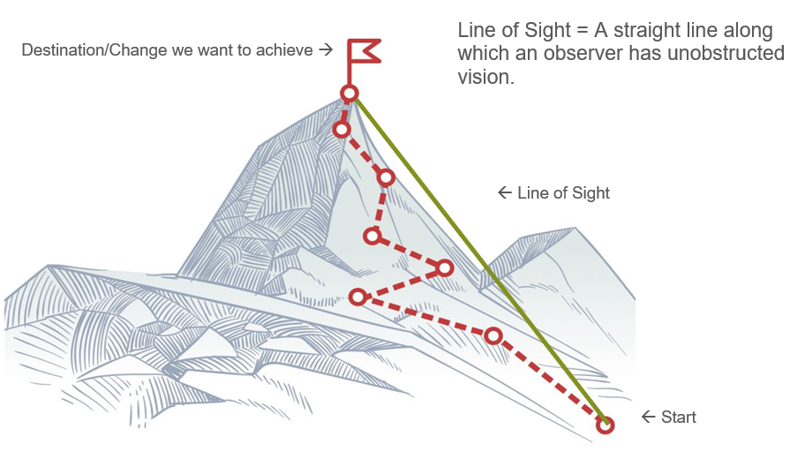
Line of Sight – a concrete, near-term change to advance
As you think about your program population and your performance measure (outcome), where do you aspire to be in the next six months? In the next year?
What is the name of the program population/group you will focus on during the Leadership Development Program?*
What qualitative targets do you want to reach? (What will be different about what you are doing, how your work will look, etc.?)
What is a measurable impact target that you want to reach to know that you are making a difference/having an impact on your program population?
*Please choose one group/program population you are comfortable talking and sharing about during the Leadership Development Program discussions. If you would like to, you may complete an additional Line of Sight worksheet for a group/Program Population that you want to work on privately.
Adapted from slides contributed by Sheila Weber, The OCL Group
Notes:
TIPS FOR DEVELOPING A LINE OF SIGHT***:
When things are quickly and continuously changing, we need to remain flexible and agile, but we must hold a strong line of sight toward equitable impacts that benefit people of color and low-income communities. A line of sight is not a result. Rather, it is a concrete, near-term change that you want to advance, one that is powerful enough to focus your efforts even when circumstances are shifting and evolving.
Within the next X # of months, what is a change that you want to advance? (Line of Sight)
How will your line of sight contribute to equitable impacts for a vulnerable population?
At X # of months, what will tell you that the change you are seeking has materialized? What will be different? (Be concrete)
***Developed by Jessica Dalesandro Mindnich and Marian Urquilla based on the work of Marilyn Darling and Fourth Quadrant Partners.

Slide 26
Tips for Developing a Line of Sight
When things are quickly and continuously changing, we need to remain flexible and agile, but we must hold a strong line of sight toward equitable impacts that, ultimately, benefit people of color and communities living with adversities. A line of sight is a concrete, near-term change that you want to advance, one that is powerful enough to focus your efforts even when circumstances are shifting and evolving.
Use your journal to document:
Within the next six (6) months, what is a change that you want to advance? (Line of Sight)
What is the name of the group of leaders you work with to advance the change?
How will your line of sight ultimately contribute to equitable impacts for a vulnerable population? (qualitative target(s))
Six (6) months to a year from now, what will tell you that the change you are seeking has materialized? What will be different? (measurable target; be concrete)
Adapted from a concept developed by Jessica Dalesandro Mindnich and Marian Urquilla based on the work of Marilyn Darling and Fourth Quadrant Partners.
Adapted from slides contributed by Sheila Weber, The OCL Group

Slide 27
THANK YOU
Questions?
marlocnash@gmail.com

Slide 28
With gratitude to:
Sheila Weber, The OCL Group
Annie E. Casey Foundation’s Results CountTM
Jolie Bain Pillsbury, PhD
Mid-Iowa Health Foundation
The Coalition for Family and Children’s Services in Iowa
The Change Leadership Vision Council

