Slide 1
Iowa Change Leadership Vision Council (Vision Council)
Founded: August 2019
Who we are: As leaders in the public and private sectors we formed the Vision Council to focus on the importance of building and re-building family and child well-being through a public health approach.
Vision: Families and children in Iowa are safe, secure, healthy and well in their communities.
What we do: The Vision Council (VC) utilizes the Results Based Accountability model and a Culture Shift model to make the vision a reality. The VC collaborates with human services providers, advocates, and state leaders to shift systems culture and create system-level solutions to make measurable progress for specified, focus populations. Initially, a study of data identified intersectional issues facing families and children, which led to identifying the focus populations. The theory is that by improving conditions, systems and outcomes for the children and families in the focus populations, there will be measurable progress toward the VC’s vision – and all of Iowa will benefit.
The VC work groups design and advance the strategies to achieve its goals and measure progress. The work groups are aligned with the focus populations:
Substance Use Disorder Work Group: Focuses on interconnectivity of substance use disorders and child maltreatment to better support families living with substance use disorders who have children ages 10 years and younger.
Older Youth Work Group: Focuses on the systemic inequities that need to be dismantled for Iowa youth of color (ages 10 and older) and their families who experience risk factors and system inequities that put them at greater risk of involvement in the child welfare or juvenile justice systems.
North Star Work Group: Focuses on the root cause of financial instability and housing insecurity that can unnecessarily lead to families being involved in the child welfare and juvenile justice systems.

Slide 2
Vision Council’s Vision and Approach
VISION: Families and children in Iowa are safe & secure, healthy & well in their communities.
How
Reach the Vision through a focus on children and families in the child welfare/juvenile systems or at-risk; through lenses of race equity and trauma.
Use Data To:
Identify Needs
Define Desired Results
Track Progress
Working Collaboratively within the Vision Council and beyond
Change the systems’ culture to be more constructive.
Notes:
FOUNDING GOAL To engage the public and private sectors to collaborate and be solution-focused to create a child welfare system to meet the needs of Iowa’s children and families living at risk of poor outcomes.
The Vision Council concluded that our vision needs to focus on all children and families in Iowa. What started as focusing on implementing Family First has evolved into discussing that we need a public health continuum approach that begins with primary prevention that structures in ways those families that come to the attention of the child welfare/juvenile justice systems or are at risk of entering the systems. In addition, keeping families together or connected in all ways possible once the come involved with either system. The Vision Council decided we needed to focus on the full continuum at its highest level (the Vision).
The Vision Council decided to reach the Vision they decided to keep a focus on children either in or at risk of being in the child welfare and juvenile justice systems. The Vision Council asked ourselves, are we looking at all children or do we want to elevate that we need to do much better on keeping kids out of the child welfare and juvenile justice systems and we need to do much more when families get involved in the system to do better for them. We also incorporated a race equity trauma into our work.
The Vision Council is committed to use data to identify needs to define the desired results that we want to achieve and to track our progress.
We work collaboratively withing the Vision Council and beyond. One of the tenants of the Vision Council is that we do not want to duplicate the work of other groups. We developed a framework and a plan, but we are constantly seeking partners to see if someone else is already working on it. We want to help our partners understand how their work might relate to the distinctive experiences and families who are at risk or involved in the child welfare/juvenile justice systems.
The Vision Council has also focused on how to make the systems’ cultures constructive. Often when you are trying to make change the cultures that are in the organizations and systems (public/private) can often stand in the way of progress and it is often an overlooked element of leading change efforts. The Vision Council decided to go through a process to make sure the culture was visible and imagined a future culture and then building skills and processes to actively move the state in all stakeholders to a new culture.

Slide 3
What is Results Based Accountability?
5-2-2 of RESULTS COUNTTM
5 Core Competencies
Be results-based and data-driven with clear targets, data to assess progress and change course.
Acts on disparities to advance equitable opportunities. Recognize that race, class and culture impact outcomes and opportunities for vulnerable children.
Use oneself as an instrument of change to move a result; individual leaders can lead from whatever position they hold.
Master the skills of “adaptive leadership,” awareness of how values, habits, beliefs, attitudes and behaviors impact action for results.
Collaborate with others, understanding that the capacity to build consensus and make group decisions enables leaders to align their actions and move work forward to achieve results.
2 Foundational Frameworks
Theory of Aligned Contributions: The right group of leaders using specific skills to align actions and make contributions from role will result in measurable population level change.
Person-Role-System: Leadership is influenced by individual preferences, professional experiences, and the role one plays in formal and informal systems.
2 Foundational Skills
Results-Based Accountability: Differentiates population and program level results, uses data to develop impactful strategies and tracks whether work is contributing to results.
Results-Based Facilitation: Leaders design, lead and contribute to meetings that move groups from talk to action and hold participants accountable for advancing the work.
Results CountTM is The Annie E. Casey Foundation’s (AECF) program for teaching and spreading the Results-Based Model. AECF developed the 5-2-2 Framework.
Notes:
The Vision Council is using the Results-Based Model to ensure a brighter future for all children and families in Iowa.
The work of leaders is to align their actions in ways that make a measurable contribution to better results for all members of a defined population
In this work, “all” means just that and focusing on all members of a defined group requires a relentless focus on equity. That focus is reflected throughout the Results-Based approach.
ASSUMPTIONS
People want to make a difference.
When people are working to make a difference, they want to KNOW (through data / evidence) that they are making a difference.
People can use the Results-Based competencies, frameworks and tools to help them know and track that they are making a difference.
If leaders perform better in role and if they align their actions with other partners, then they will have greater and more equitable impact on the populations they are working with and on behalf of.

Slide 4
Vision Council Data Observations
Note: Observations were made as part of a data walk and analysis conducted in August 2019. Since that time, the Vision Council has been working on addressing the issues identified through the data walk.
Iowa child welfare system stakeholders need to use data to drive decision making and change practices.
Data illustrates racial bias in Iowa systems that needs to be addressed.
There are root causes to families becoming involved in the child welfare system.
Systems need to be trauma-informed because children and families are living with the trauma of root causes, ACEs and toxic stressors.
Substance use disorders show up at a high-level in the data but are not a major focus of FFPSA implementation. (Note: This has since been remedied by the Vision Council with the start up of the Substance Use Disorders Work Group.)
System stakeholders need to work together to address root causes, prevent child maltreatment and prevent trauma.

Slide 5
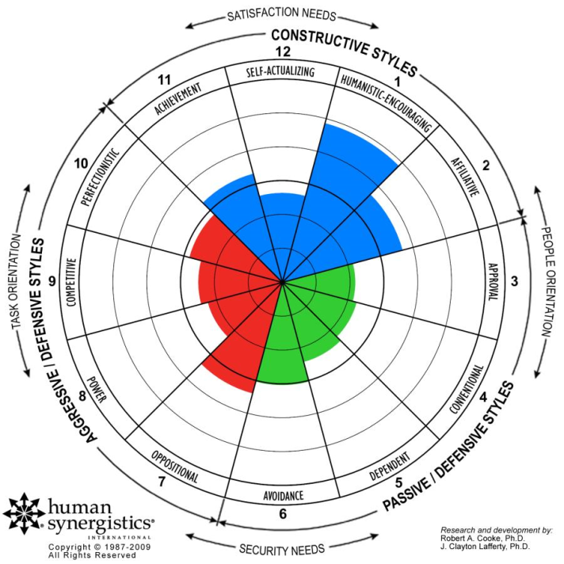
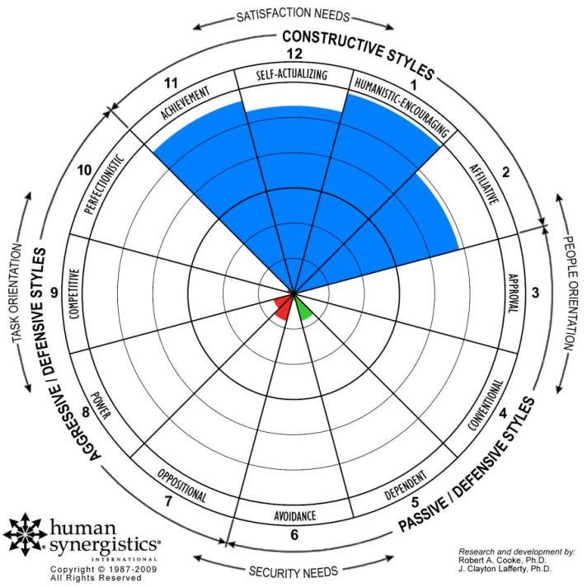
Iowa Families First Vision Council
Current Culture versus Ideal Culture
Current Culture N=23
Ideal Culture N=14
Research and Development by: Robert A. Cooke, Ph.D. and Janet L. Szumal, Ph.D.
Human Synergistics International Copyright © 2014. All Rights Reserved.
Notes:
Early on in the process (Fall 2019), we used the human synergistics model which helped us conduct a survey of stakeholders asking them to identify the state of the current culture. We won’t got into too much detail, but we I will point out is a portion of the circumplex has an aggressive defensive styles, passive defensive styles on the bottom and at the top it is constructive styles.
We surveyed health and human services providers, representatives from the judicial system, representatives from DHS and all members of the Vision Council.
Process wise, stakeholders do a survey on one day on how they access the current culture and the next day they get another survey to weigh in on what they want the ideal culture to be.
The survey respondents identified a good bit of aggressive defensive styles, some passive defensive styles and some constructive styles that are already in place that could be built upon.
On the right, the commentary through the survey of what the ideal culture that they would like to have in the state moves everything to a much more constructive style/space.

Slide 6
The Vision Council’s Core Beliefs To achieve the vision, Iowa leaders and systems need to:
Be Family-Centered.
Iowa systems need to take a family-centered approach where each individual and family receives support when needed. Children and parents experience better outcomes when their needs are addressed together. Families are the experts of their own family unit.
Cultivate Collaborative and Interconnected Systems.
Children and parents experience better outcomes when their needs are addressed holistically. A multi-systems approach focused on ensuring equity and addressing root causes is necessary to meet the full range of families’ needs.
Respond to Trauma.
All public and private systems need to be healing-centered, trauma-informed and equipped to model and support relational health.
Support Recovery.
Substance use disorder is a disease that can be treated; recovery is possible.
Address Root Causes.
Housing instability, financial insecurity, and child care challenges are highly correlated with child maltreatment and must be eliminated. The circumstances and effects of poverty are frequently the cause of child neglect and can be addressed.
Embed Knowledge of Development.
The developmental needs of young children and adolescents are distinct and deserve attention, intention and investment. Whatever the reason children and youth come to the attention of the child welfare and juvenile justice systems and whatever the behavior displayed, our systems must respond in ways that nurture healthy development, offer healing, and ensure connections to family and social networks.
Secure Access & Opportunity.
Programs and initiatives that offer equitable opportunities for all populations are important to healthy communities and a strong economy.

Slide 7
Change Leadership Vision Council
System Culture Shift
FROM Defensive Style | TO Constructive Style
Current Assessed State: Compliance Mindset | Overall Goal for the System: Move to a Value-Based Mindset
Current Assessed Behaviors: | Ideal Behaviors:
1. Communicating only “What” | 1. Communicating “What and Why”
2. Fix-it Mindset | 2. Progress Mindset
3. Fear of risk and change | 3. Be an agent of change, be proactive and increase advocacy
4. Geographic Alignment | 4. Goal Alignment
5. Outcomes measured by negative indicators | 5. Outcomes measured by positive indicators
This System Culture Shift proposal was drafted by the Change Leadership Vision Council, a public-private initiative convened by The Coalition for Family and Children Services in Iowa, funded by the Mid-Iowa Health Foundation.
CONTACT: Kristie Oliver, Executive Director, at Kristie@iachild.org

Slide 8
Whole Population to System Population to Focus Populations
Vision: Families and children in Iowa are safe, secure, healthy and well in their communities.
FOCUS #1: Families living with SUDS who have children (prenatal to 10)
FOCUS #2: Youth of color (ages 10 and older) and their families
FOCUS POPULATIONS
#1: Families living with SUDs who have young children ages prenatal to 10
#2: Iowa youth of color (ages 10 and older) and their families
SYSTEM POPULATION
Families and children involved in the child welfare or juvenile justice systems, or at risk of becoming involved.
WHOLE POPULATION All families & children in Iowa

Slide 9
Results Action Plan Summary Families and children in the focus populations:
Result 1: Thrive together as families.
Target: By 2026, increase permanency* with family for children and youth in the target populations.
Result 2: Are connected to permanent housing.
Target: By 2026 increase the percentage of households without severe housing problems to 92% statewide.
Result 3: Have a family economic profile that equates to a moderate, adequate standard of living.
Target: By 2026, cut child poverty from 44% to 22%.
Result 4: Receive family-centered, recovery-oriented Substance Use Disorder treatment, when needed.
Target: Safely increase the number of families who remain intact while in recovery by 10% each year beginning in 2023.
*Permanency means family. It means having positive, healthy, nurturing relationships with adults who provide emotional, financial, moral, educational and other kinds of support as youth mature into adults. Ideally, permanency takes the form of a relationship that has a legal component that provides a parent-child relationship.
Notes:
Results Action Plan Summary
Families and children in the Focus Populations:
Result 1: Thrive together as families.
Target: By 2026, reduce entries into the child welfare and juvenile justice systems among families in the Focus Populations by (# or %).
Progress Indicator: TBD (Baseline: TBD, will be based on Progress Indicator)
Strategies:
1.1 Establish trauma-informed, healing-centered systems
1.2 Support and strengthen relationships among children, youth, parents and
families
Result 2: Are connected to permanent housing.
Target: By 2026, 94% of Iowa families with children are living in safe, affordable housing.
Progress Indicator: TBD (Baseline: TBD, will be based on Progress Indicator)
Strategy:
2.1 Ensure there is a concerted, results-focused effort to provide permanent housing options for families in the Focus Populations.
Result 3: Have a family economic profile that equates to a moderate, adequate standard of living.
Target: By 2026, cut child poverty from 44% to 22%.
Progress indicator: Percent of children below 250 percent poverty in Iowa (Baseline: 44% (National KIDS COUNT Database, 2019))
Strategy:
3.1 Ensure families have economic opportunities, and are connected to material and concrete supports, when needed.
Result 4: Receive family-centered, recovery-oriented Substance Use Disorder treatment, when needed.
Target: Safely increase the number of families who remain intact while in recovery by 10% each year beginning in 2023.
Progress Indicator: TBD (Baseline: TBD, will be based on Progress Indicator)
Strategy:
4.1 Establish a family-centered, recovery-oriented, integrated system of care for treating Substance Use Disorders (SUDs).
[Working to select a data point to track that will not have any unintended consequences.]
[Working with housing experts to help decide between “Severe Housing Problems in Iowa” or “Children Living in Crowded Housing” or another/different recommended progress indicator.]
[Working to prepare a Request for Information to DHS that will inform the selection of a Progress Indicator.]

Slide 10
Results Action Plan Summary by Result Families and children in the focus populations:
Result 1: Thrive together as families.
Target: By 2026, increase permanency* with family for children and youth in the target populations.
Progress Indicator: Reduction in number of children who experience out of home placement.
(Source: Iowa Health & Human Services, Child Welfare Division)
Key strategies (plus FY23 priorities listed):
1.1 Establish trauma-informed, healing-centered systems
1.1.2 Determine ways to support the establishment of an Office of Youth Development (OYWG)
1.1.3 Build a culturally and content competent health, housing and human services workforce that reflects the diversity of Iowa communities.
1.2 Support and strengthen relationships among children, youth, parents and families
1.2.1 Develop a centralized, single point of contact for case coordination & service navigation, providing warm handoffs where appropriate
1.2.7 Adopt and implement a comprehensive family identification and engagement model to prevent unnecessary family separation and support youth and children who are placed into care systems. (NSWG)
1.2.9 Determine the ways to support the establishment of a Crossover Youth Practice Model (OYWG)
1.2.10 Extend Iowa’s pre-charge/pre-arrest diversion program statewide for all youth with first-time, simple offenses.

Slide 11
Results Action Plan Summary by Result Families and children in the focus populations:
Result 2: Are connected to permanent housing.
Target: By 2026 increase the percentage of households without severe housing problems to 92% statewide.
Progress Indicator: Reduction in percentage of households with several housing problems.
(Source: Comprehensive Housing Affordability Strategy (CHAS) data; accessible through County Health Rankings & Roadmaps)
Key Strategy (plus FY23 priority listed): :
2.1 Ensure there is a concerted, results-focused effort to provide permanent housing options for families in the Focus Populations.
2.1.1 Determine whether a family housing collaborative is needed or a voice for children/families within housing conversations, decision making and advocacy.

Slide 12
Results Action Plan Summary by Result Families and children in the focus populations:
Result 3: Have a family economic profile that equates to a moderate, adequate standard of living.
Target: By 2026, cut child poverty from 44% to 22%.
Progress Indicator: Percent of children below 250 percent poverty in Iowa
(Baseline: 44% (National KIDS COUNT Database, 2019))
Key Strategy (no priority identified for FY23):
3.1 Connect families to supports that equate to a moderate, adequate standard of living.

Slide 13
Results Action Plan Summary by Result Families and children in the focus populations:
Result 4: Receive family-centered, recovery-oriented Substance Use Disorder treatment*, when needed.
Target: Safely increase the number of families who remain intact while in recovery by 10% each year beginning in 2023.
Progress Indicator: TBD (See note in ”Comments”)
Key Strategy (plus FY23 priorities listed): :
4.1 Establish a family-centered, recovery-oriented, integrated system of care for treating Substance Use Disorders (SUDs).
4.1.1 Advocate for a commitment to a family-centered, recovery-oriented system of care for treating Substance Use Disorders (SUDs) that bridges the Child Welfare System and Behavioral Health System.
4.1.2 Conduct statewide education of child and adult behavioral health coalitions and providers on new opportunities to serve families via FFPSA
*The National Center on Substance Abuse and Child Welfare offers the Family-Centered Approach Modules, which could be a vital resource for the Vision Council for the Key Strategy: 4.1 Establish a family-centered, recovery-oriented, integrated system of care for treating SUDs.

Slide 14
Vision Council’s To Do List as of Fall 2022
VC.1 Further develop and implement detailed action steps to achieve the Strategies in the Results Action Plan.
VC.2 Finalize Progress Indicators (at least one for each Result; see “Potential Progress Indicators” on slide X for ideas-to-date from the Vision Council)
VC.3 Capture the “Story Behind the Curve” to explain why the Vision Council has selected the Results in the Plan and the Key Strategies (Helpful resources: 1) See notes section for this slide; 2) The Results –Based AccountabilityTM Guide, Clear Impact, page 6, “What is the Story Behind the Curve?”)
VC.4 Development of Performance Measures and Action Steps (Helpful Resource: The Results –Based AccountabilityTM Guide, Clear Impact, pages 12-15, “Appendix A: Performance Measures” – ask “How much did we do? How well did we do it? Is anyone better off?”)
VC.5 Build Roster of Aligned Partners for each Result
VC.6 Devise Results Action Plan Companion Documents
Data Set of Progress Indicators, Trend Lines
Data Measurement Calendar & Process
Logic Model
Policy Advocacy Agenda
The Results-Based AccountabilityTM Guide
from Clear Impact is, generally, a helpful
resource for continuing the development
and implementation of the Vision Council’s
Results-Action Plan. There are helpful links
on page 16 that offers examples from
around the country.
Notes:
For the Story Behind the Curve relative to Focus Population #1 – Families living with SUDs – remember that the SUD Work Group drew heavily from the report Substance Use Among Iowa families: An Intergenerational Mixed Method Approach for Informing Policy and Practice, which centers the input of Iowa families with lived experience. Link to report: https://i2d2.iastate.edu/wp-content/uploads/2021/01/Dorius-Sept2019-Substance-Use.pdf

Slide 15
Potential Progress Indicators
The Vision Council generated ideas for additional progress indicators. These could be tracked in addition to the major progress indicator that is selected for each Result in the Results-Action Plan.
# of youth of color who age out of foster care
# of youth of color reunited with family
# of young of color removed
# of children who experience out of home placement
# of youth of color living with “kin”
# of confirmed/founded cases with Substance Use Disorders as type
# of Family –Centered Treatment beds (contracted through DHS for FFPSA? Women & children organizations? Youth beds?)
# of families engaging in services (FFPSA services? Pre-Child Welfare System services?)
Can data be captured that would track protective factors ?
Could data be useful from 988 calls that come from families?
Is there data statewide for housing?
Is there data for urban vs rural housing?

Slide 16
Strategies, Activities & Action Steps by Result FY23 Priorities Noted
Result 1: Thrive together as families (1.1)
1.1 Establish trauma-informed, healing-centered systems Iowa’s family support, child welfare, juvenile justice, early childhood, education, health, law enforcement, juvenile justice, early childhood, education, health, law enforcement, judicial and labor/workforce systems are trauma-informed and healing-centered.
1.1.1 A multi-system collaborative effort is put in place and charged with implementing this strategy (possible partners: Iowa ACES 360, Prevention Child Abuse Iowa, HHS, JCS, Early Childhood IA, DOE, law enforcement entity, judicial entity, state labor/workforce representative, state Chamber of Commerce representative)
1.1.1.a Secure the commitment from each system to appoint a representative to this strategy.
1.1.1.b Create a shared, understood, and research-informed definition of “trauma-informed and healing centered.”
1.1.1.c Multi-system collaborative develops a work plan.
1.1.2 Determine ways to support the establishment of an Office of Youth Development that consistently applies neuroscience & adolescent development knowledge to systems, policies, services & practices in the Child Welfare and Juvenile Court Systems.
1.1.2.a In FY23, gather information, e.g. meet with Indiana leaders; meet with Iowa Early Childhood Initiative leaders; Meet with Steve Michael and Doug Wolfe. (OYWG)
1.1.2.b In FY23, identify and invite partners and advocates (perhaps a formal agreement with CJJP that defines roles and tasks of each partner). (OYWG)
1.1.3 Build a culturally and content competent health, housing, and human services workforce that reflects the diversity of Iowa communities
1.1.3.a In FY23, Vision Council and Cultural Equity Alliance forma. Partnership that defines roles & tasks for each partner. (NSWG)
1.1.4 Establish trauma-informed, culturally responsive, and non-traditional practices that meet the needs of Black, Indigenous, People of Color (BIPOC)

Slide 17
Strategies, Activities & Action Steps by Result FY23 Priorities Noted
Result 1: Thrive together as families (1.2)
1.2 Support and strengthen relationships among children, youth, parents and families
1.2.1 Develop a broad definition of “family” to increase the reach and impact of this Results Action Plan (inclusive of all family types and informed by the cultures present in Iowa; the definition of family is adopted and consistently applied in systems, policies, services and practices across public and private health, human services and housing systems)
1.2.2 Develop a centralized, single point of contact for case coordination & service navigation, providing warm handoffs where appropriate
1.2.2.a Monitor HHS plans, provide advocacy/feedback as needed, to ensure this is in the Alignment Plan (New HHS includes “community concierge” concept in the Alignment Plan, dedicates resources, and establishes a project plan and timeline.) (SUDWG)
1.2.3 Train all case manager and navigator roles in core competencies that center and support family connectedness (All entities that employ case managers or navigators who interact with families (housing, child welfare, behavioral health, SNAP/WIC, etc.) are formally committed to using a common orientation/training curriculum that develops core competencies)
1.2.3.a Identify a funding source for this activity. (Check with Marisa Eyanson for possibility of Medicaid funding?)
1.2.4 Increase availability of culturally response home visiting and other community-based programs
1.2.5 Invest in Family Resources Centers as a place families can access support in lieu of formal system involvement with the Child Welfare and Juvenile Court Systems. (Every family in Iowa has a Family Resource Center within X miles of where they live.)
1.2.5.a Identify entities that support this Activity and pursue a collaborative effort to develop an initiative/campaign. (A collaboration of key stakeholders is assembled and charged to make Family Resource Centers a reality across Iowa.)
1.2.6 Family-centered services and after care/re-entry services and support are available statewide for children, youth and families of all types who are connected to the CWS (birth, resource, kin, foster, adoptive) so families can successfully reunite after out of home placement/residential-based care, mentorship for family)
1.2.7 Adopt and implement a comprehensive family identification and engagement model to prevent unnecessary family separation and support youth and children who are placed into care systems.
1.2.7.a In FY23, assess the current status of “family finding” efforts (how they are funded, who is doing them in state and/or modeling them in other states, who supports this Activity in Iowa) (NSWG)
1.2.8 Ensure interventions are available and accessible to families throughout the state that are age and culturally aligned (crisis intervention, mediation, therapy, Evidence-Based Practices such as Functional Family Therapy)
1.2.8.a Apply the lens of race and cultural equity to the selection of Evidence-Based Practices included in Iowa’s IV-E Prevention Plan.

Slide 18
Strategies, Activities & Action Steps by Result FY23 Priorities Noted
Result 1: Thrive together as families (1.2, continued)
1.2 Support and strengthen relationships among children, youth, parents and families, continued
1.2.9 Determine the ways to support the establishment of a Crossover Youth Practice Model (OYWG)
1.2.9.a In FY23, work with Chief Justice Christensen to identify how the Vision Council can support her leadership toward developing a Crossover Youth Practice Model (Vision council has a clear understanding of what role it can play to bring the Crossover Youth Practice Model to Iowa.) (OYWG)
1.2.10 Extend Iowa’s pre-charge/pre-arrest diversion program statewide for all youth with first-time, simple offenses. (OYWG)
1.2.10.a In FY23, Vision Council brings healing-centered model to existing/newly-funded pre-charge/pre-arrest diversion programs. (OYWG)
1.2.10.b In FY23, meet with the entity that is leading current efforts to identify how the Vision Council can support replication. (OYWG)

Slide 19
Strategies, Activities & Action Steps by Result FY23 Priorities Noted
Result 2: Are connected to permanent housing (2.1)
2.1 Ensure there is a concerted, results-focused effort to provide permanent housing options for families in the Vision Council’s Focus Populations
2.1.1 Determine whether a family housing collaborative is needed or a voice for children/families within housing conversations, decision making and advocacy.
2.1.1.a In FY23, work with housing experts at local & statewide agencies to “deepen bench” of housing expertise and map out our next steps to creating more affordable housing options for our target populations.(NSWG)
2.1.1.b In FY23, bring MCOs into alignment and partnership with the Vision Council’s Results Action Plan and engage them in achieving the target for housing. (NSWG) [Note: Recommended by consultant (Marlo Nash) based on past conversations the VC has had, and knowing that the new MCO contracts are settled.]
2.1.1.d Conduct a national landscape review of housing initiatives and projects that are geared toward the VC’s Focus Populations and Target for this strategy. Possible sources: California’s Bringing Families Home and Children’s Wisconsin’s Institute for Child and Family Well-Being’s HOMES Initiative, Housing Opportunities Made to Enhance Stability (HOMES) Initiative (VC is aware of two or more models at work in other states that could inform a detailed plan on ensuring stable housing for Iowa families and children.)
2.1.1.e Explore the concept of assessing for housing needs as a universal question in any client needs assessment by any agency, but definitely CWS, BH, MH and family resource agencies (Is there a technology solution?)
2.1.2 Enact a statewide Supportive Housing model/network as one strategy to address the housing needs of the Focus Populations.
2.1.3 Partner with local and statewide housing agencies to renovate or build affordable housing units that offers families with children safety, security, and a sustained community connection. (NSWG)
2.1.3a Explore state and local building code amendments to allow more affordable and flexible build options. (NSWG)
2.1.4 Increase pathways to home ownership for Black and Brown families. (Note: It will be important to assure that home ownership practices and policies – for any and all populations – do not carry any unintended consequences for the population.)
2.1.4.a Include a focus on home ownership and permanent housing options for Black and Brown families in the plan that the collaborative effort on housing for families is tasked to prepare.

Slide 20
Strategies, Activities & Action Steps by Result FY23 Priorities Noted
Result 3: Have a family economic profile that equates to a moderate, adequate standard of living. (3.1)*
3.1 Connect families to supports that equate to a moderate, adequate, standard of living.
3.1.1 Ensure statewide access to a menu of instrumental supports, including supportive housing. (Potential key partner: YSS/Andrew Allen) (SUDWG)
3.1.1a. Identify financing streams that are at work/could work together to achieve a full scope of instrumental supports for families to prevent entry into CWS/JJ and to provide families who are involved CWS or JJ (Possible partners: MCOs; Cross-Systems Collaboration)
3.1.1.b Identify best practices from other states/localities
*It was noted in the planning process that this Result needs much more work. There are no priorities within it for FY23. It is missing workforce policies, etc.

Slide 21
Strategies, Activities & Action Steps by Result FY23 Priorities Noted
Result 4: Receive family-centered, recovery-oriented Substance Use Disorder treatment, when needed. (4.1)
Strategy 4.1: Establish a family-centered, recovery-oriented, integrated system of care for treating Substance Use Disorders (SUDs).
4.1.1 In FY23, advocate for a commitment to a family-centered, recovery-oriented, integrated system of care for treating Substance Use Disorders that bridges the Child Welfare System and the Behavioral Health System. (SUDWG)
4.1.2 In FY23, developways to uplift NCSACW cross-systems training for child welfare, judicial, provider systems (ex’s, Governor’s Conference) (Possible partners: YSS, MCOs, Iowa Behavioral Health Association, CAMHI for Kids) (SUDWG)
4.1.2.a Offer a call to action webinar for adult behavioral health providers, in partnership with MCOs
4.1.3 Shift the mental model among judicial district team members to “SUD is a disease that can be treated” through utilization of the Collaborative Value Inventory (CVI) survey to identify the unconscious bias of newly on boarded employees that serve our target population
4.1.3.a Do a training for all districts starting with the Child Justice Work Group (key partner: Iowa Children’s Justice Center)
4.1.4 Increase Family Treatment Courts to statewide coverage. (Lead: Iowa Children’s Justice Center)
4.1.4.a Work with ICJ to define a role for the Vision Council in support of ICJ’s ongoing work with its Family Treatment Court partners.
4.1.5 Achieve an adequate number of family-based residential treatment centers for SUD that treat mothers, fathers and children together. [Discussion Item: should this include “to treat behavioral health and mental health issues – not just SUDs – to include community-based and in-patient/residential; also, if expanding in this way, should this item move to Result 1?]
4.1.5.a Establish baseline, i.e. # of beds & waiting lists; avg length of stay per facility; resource flows
4.1.5.b Gain greater clarity around what the VC wants from this strategy.
4.1.6 Ensure there are community-based mental and behavioral health options, including a focus on the distinct needs of the VC’s Focus Populations, esp Black, Indigenous, children and youth of Color
Notes:
*The National Center on Substance Abuse and Child Welfare offers the Family-Centered Approach Modules, which could be a vital resource for the Vision Council for the Key Strategy: 4.1 Establish a family-centered, recovery-oriented, integrated system of care for treating SUDs.

